Slide 1
System Design & Analysis
Lecture 07

Slide 2
Use case Relationship
Some use cases have similar step in their behavior
Others may have different modes or special cases
Describing such use cases may cause to repeat them in the diagrams
This will lead to large and complicated diagrams
UML provides different notations for representing these behaviors

Slide 3
<<include>> Relationship
A use case may reuse all the steps from another use case
It “includes” the steps from another use case
This can be described through <<include>> relationship [also known as Gil maze]
In diagram, shown as a dashed arrow between use case with <<include>> label
Tail end it towards the use case that reuses the steps
Arrow end points towards the use case that is reused
Include use cases are mandatory and not optional

Slide 4
<<include>> Notation
Including use case
<<include>>
Included use case

Slide 5
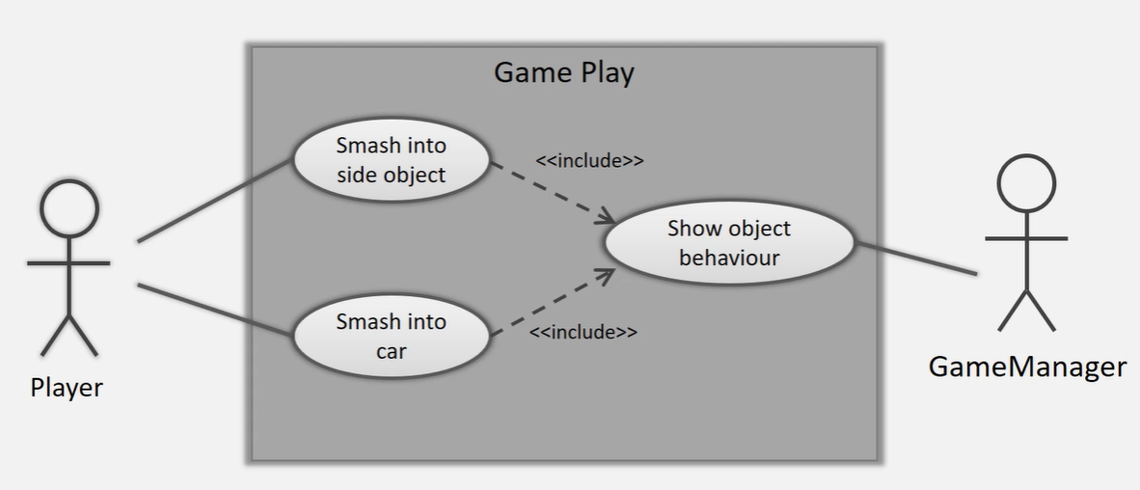
Example: <<include>>

Slide 6
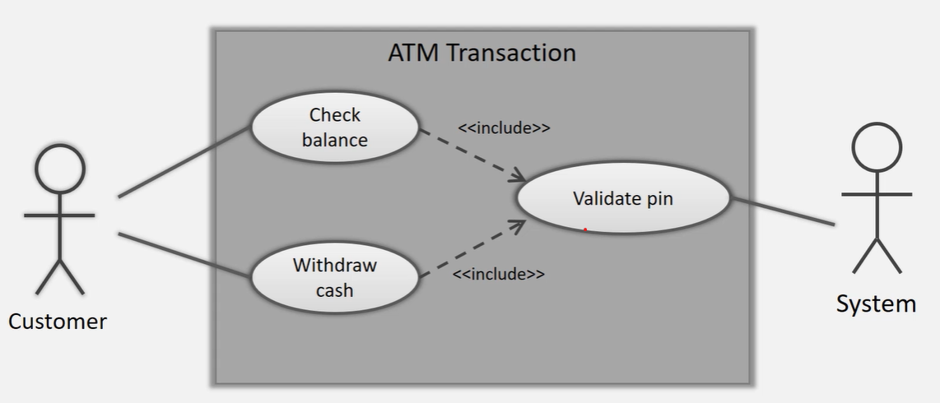
Example: <<include>>

Slide 7
Generalization
This is similar to inheritance in object oriented programming.
Used to show that one use case is a type of another, but with some changes
Depicted through the generalization arrow
Arrow head points to generalized use case
Tail point to specialized use case

Slide 8
Generalization Notation
Parent
use case
Child use case
Child use case

Slide 9
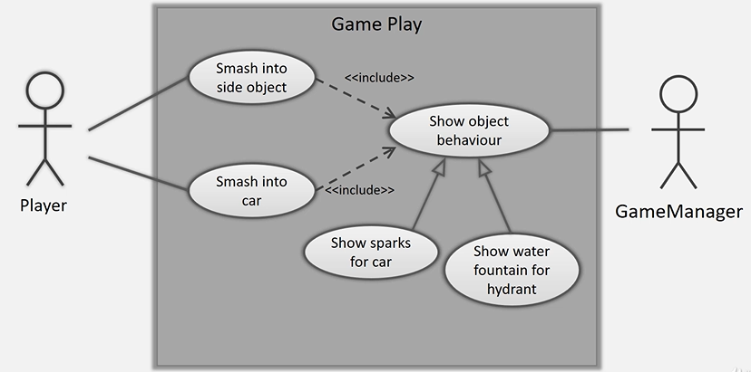
Example: Generalization

Slide 10
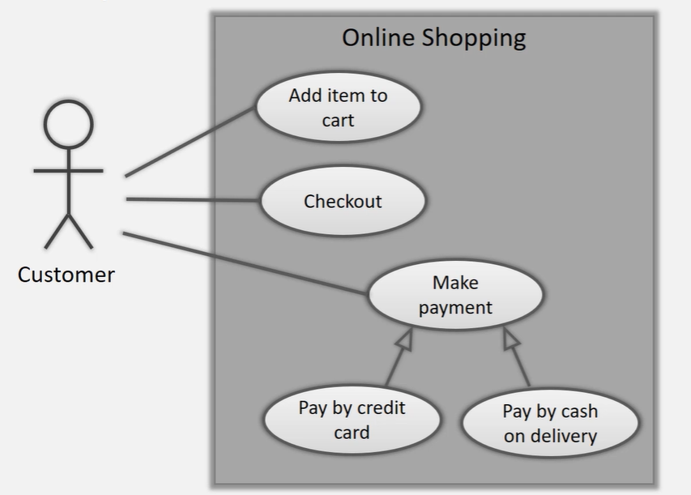
Example: Generalization

Slide 11
<<extend>> Relationship
This is used to specify an optional behaviour
This behavior appears as an extended use case
Independent of the main use case, but owned by it
Shown as a dashed arrow with <<extend>> label
This behaviour is optional [whether it executes or not depends on some factor]

Slide 12
<<extend>> Notation
Base use case
<<extend>>
Extended use case

Slide 13
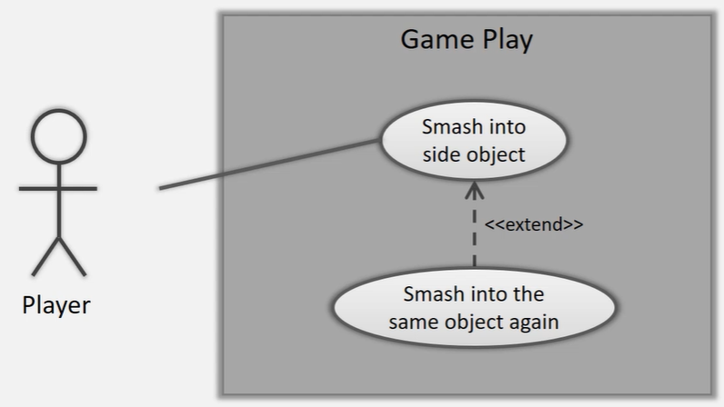
Example: <<extend>>

Slide 14
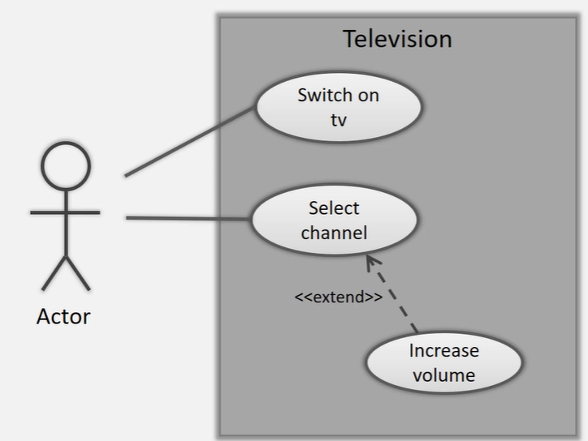
Example: <<extend>>

Slide 15

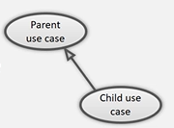
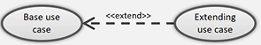
Summary
<<include>>
Reuse steps from another use case mandatorily
Generalization
One use case is type of another with some change
<<extend>>
Optional behavior of a use case

Slide 16
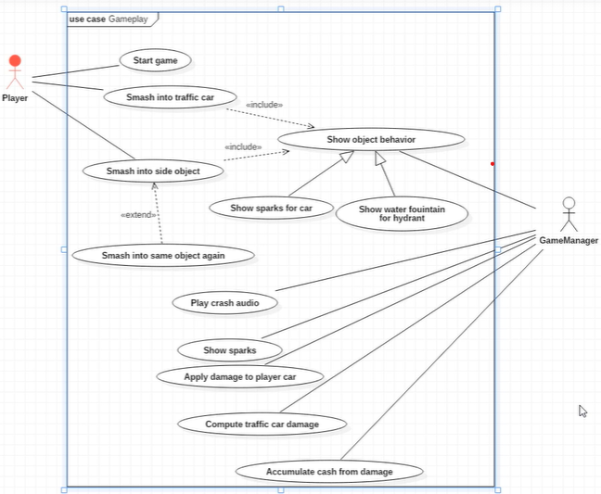

Slide 17
Guideline: Use case Description
Start with goal
Write the use case as narratives[e.g like a story]
Use simple language
Keep the technology specific out
Don’t include UI elements in use case
Every use case should give one guarantee about the behavior of the system

Slide 18
Guideline: Use case Diagram
Actors are the black box
Actors don’t interact with each other
Primary actor on left side and secondary actor on right side
Place use case in logical order
Place included use case to right of the invoking use case
Place inheriting use case below parent use case

Slide 19
Example
Customer types the pin number in the textbox on the screen
Encrypt the pin and perform an exact match with the encrypted pin stored in the web server
System will execute the sql query “insert into table records (…)” after transaction
Customer will click the “checkout” button that will send HTTPS request to the server to prepare the system for presenting the payment options
Customer enter the pin
Validate pin
System will update the database4
Customer will checkout the item

